Slide 1

CA1 Assignment
HDB analysis by Randhir Prem

Slide 2
Dataset
Dataset 1 - FlatsConstructedByHousingAndDevelopmentBoardAnnual.csv
https://beta.data.gov.sg/datasets?formats=CSV&agencies=Housing+and+Development+Board+%28HDB%29&sort=Last+updated&query=Flats+Constructed+By+Housing+And+Development+Board+Annual&resultId=d_f43ed2489fad49824702c2169561a432
Dataset 2 - ResaleTransactionsbyFlatTypebasedonregisteredcases.csv
https://beta.data.gov.sg/datasets?formats=CSV&agencies=Housing+and+Development+Board+%28HDB%29&sort=Last+updated&query=Resale+Transactions+by+FlatT+ype+based+on+registered+cases&resultId=d_27af98d638a80103319cb7499c220fe6
Dataset 3 - ResaleflatpricesbasedonregistrationdatefromJan2017onwards.csv
https://beta.data.gov.sg/datasets?formats=CSV&agencies=Housing+and+Development+Board+%28HDB%29&sort=Last+updated&resultId=d_8b84c4ee58e3cfc0ece0d773c8ca6abc

Slide 3
Information about the dataset 1
FlatsConstructedByHousingAndDevelopmentBoardAnnual.csv
Title | Column name | Data type | Unit of measure | Description
Year | year | Datetime (Year) "YYYY" | - | -
Flats Constructed | flats_constructed | Numeric (General) | No. of Flats | -
The data-set is from the years 1977-2017. A line-graph will be used to show the trend key peaks will be used to identify town creations. Evidence will be more BTO homes built.

Slide 4
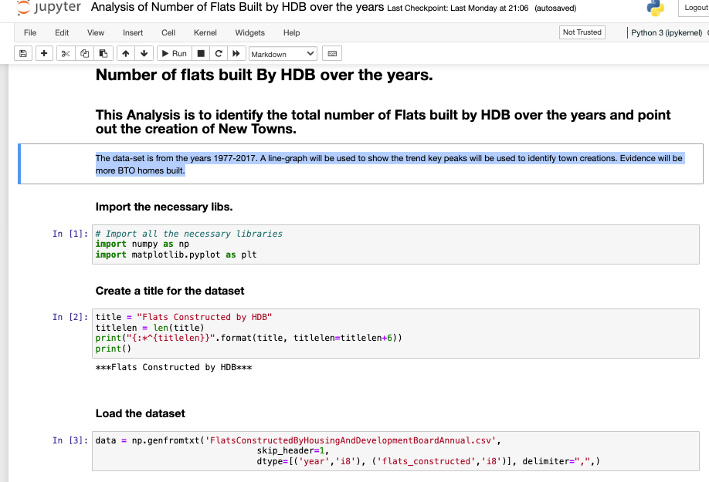
The code

Slide 5
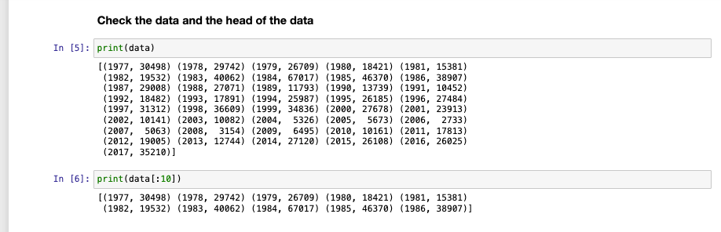
The code

Slide 6
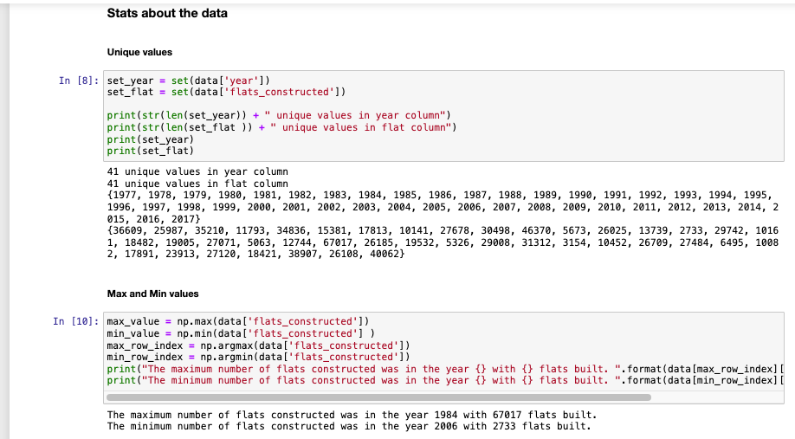
The code

Slide 7
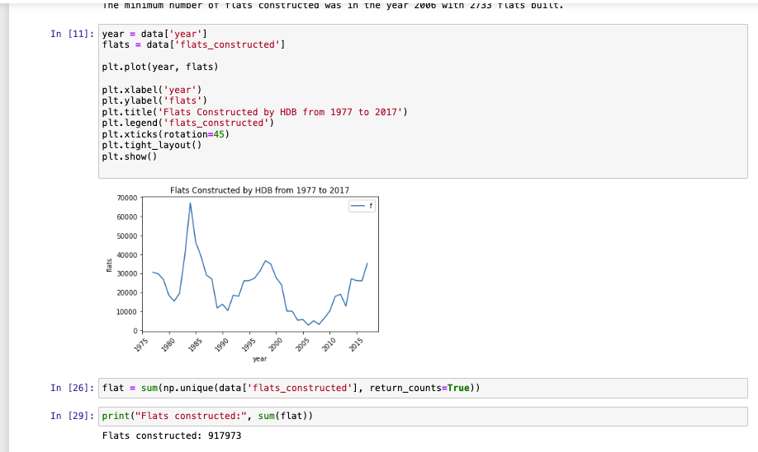
The code

Slide 8
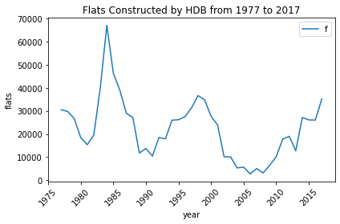
The graph

Slide 9
Summary for dataset 1
From the graph we can identify the following
1.) 1984 was a significant year with 67017 flats constructed
2.) Just before 2000, 1998 to 1999 there was many flats constructed
3.) 2013, 2015 and onwards it is increasing

Slide 10
Information about dataset 2
ResaleTransactionsbyFlatTypebasedonregisteredcases.csv
Title | Column name | Data type | Unit of measure | Description
Financial Year | financial_year | Datetime (Financial Year) "YYYY" | - | -
Flat Type | flat_type | Text (General) | - | With effect from 2014, there are no HUDC flats under HDB's management.
Resale Transactions | resale_transactions | Numeric (General) | Count | -
The data-set is from the years 2006 to 2021. We will identify the most popular flat types based on resale transactions. We will identify the 80% of the bulk of flats to use for the next set of analysis.

Slide 11
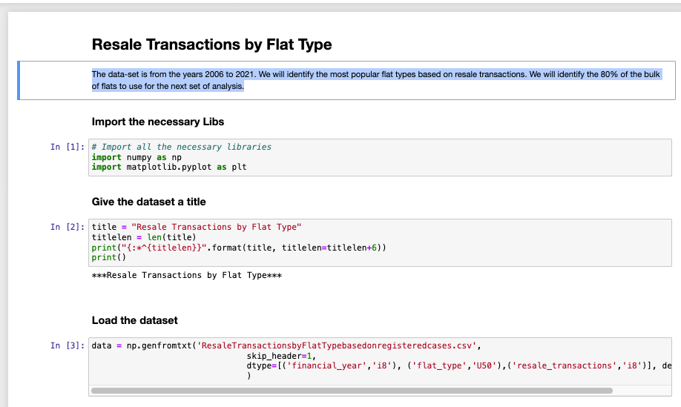
The code

Slide 12
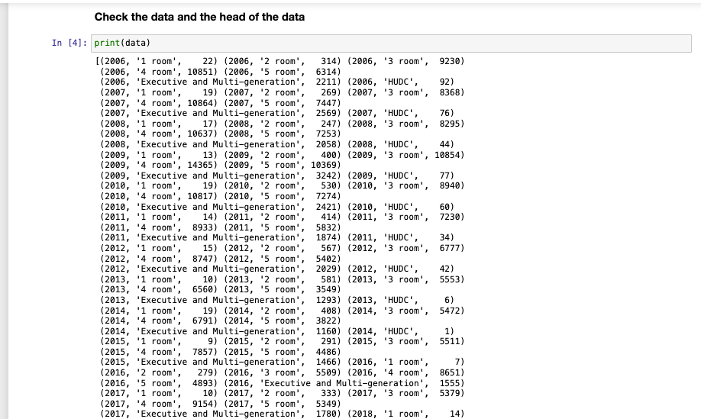
The code

Slide 13
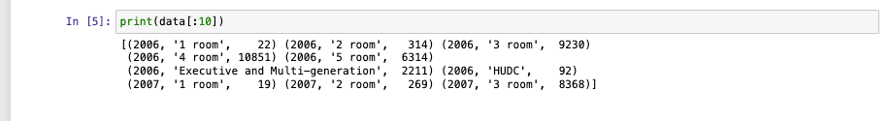
The code

Slide 14
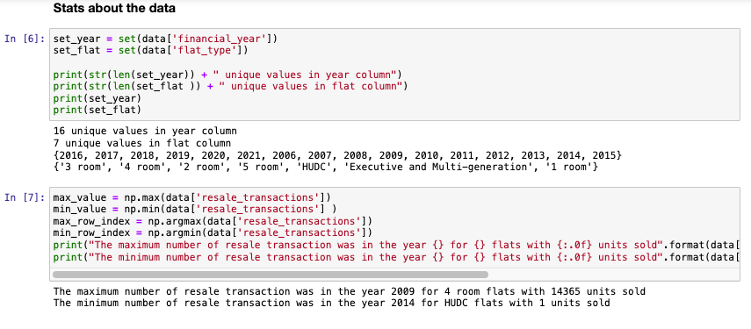
The code

Slide 15
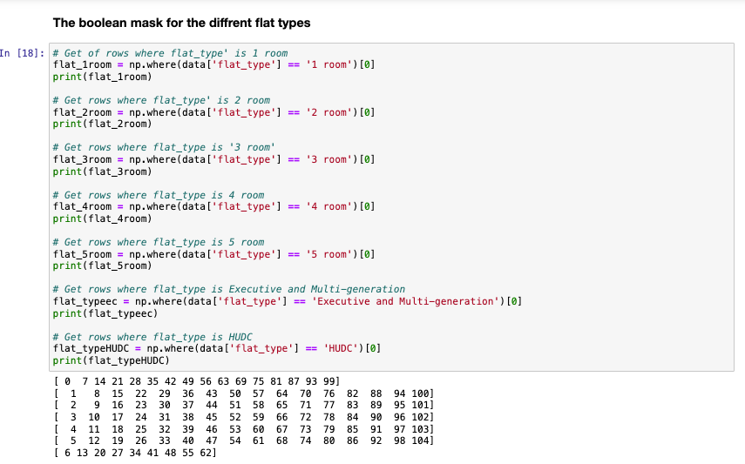
The code

Slide 16
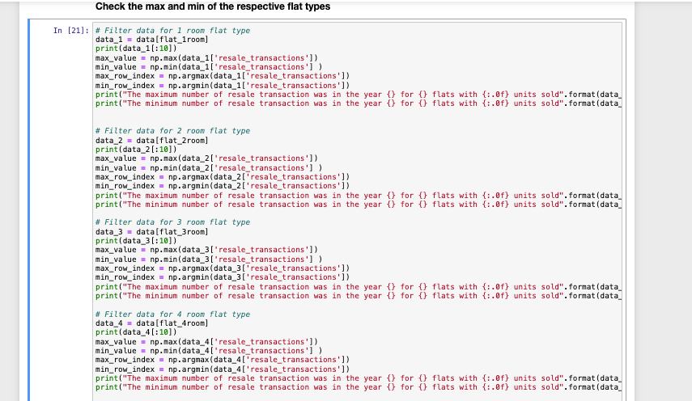
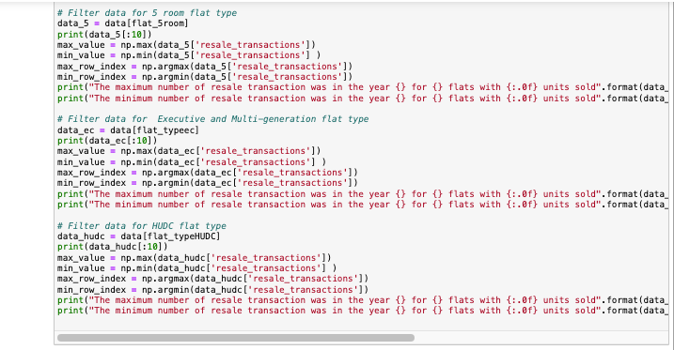
The code

Slide 17
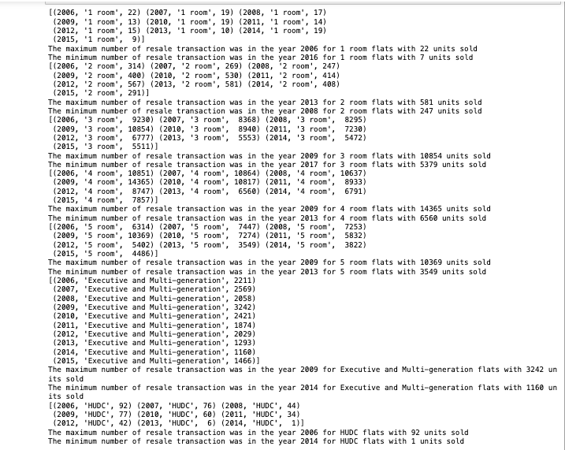
The code

Slide 18
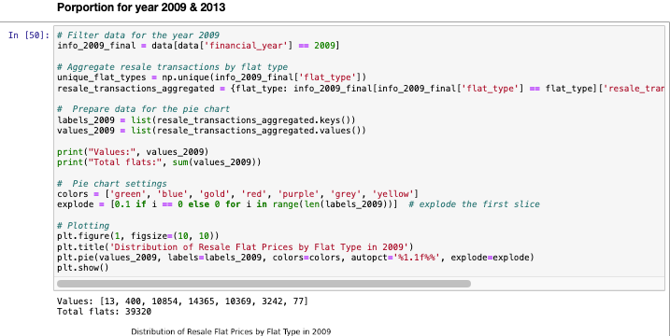
The code

Slide 19
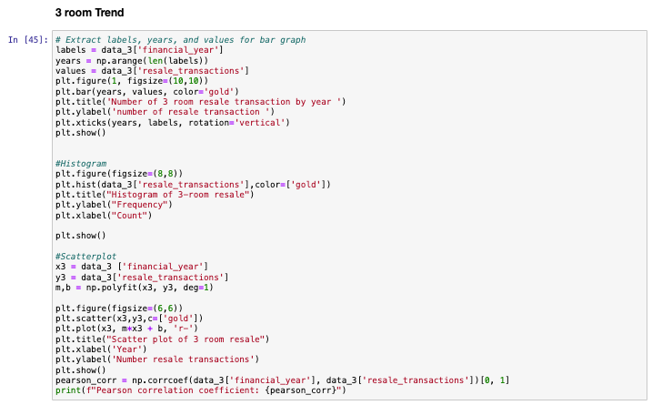
The code

Slide 20
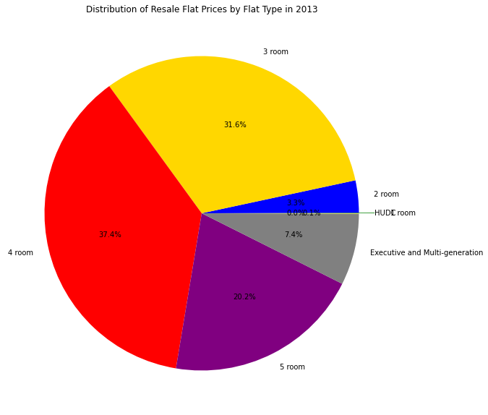
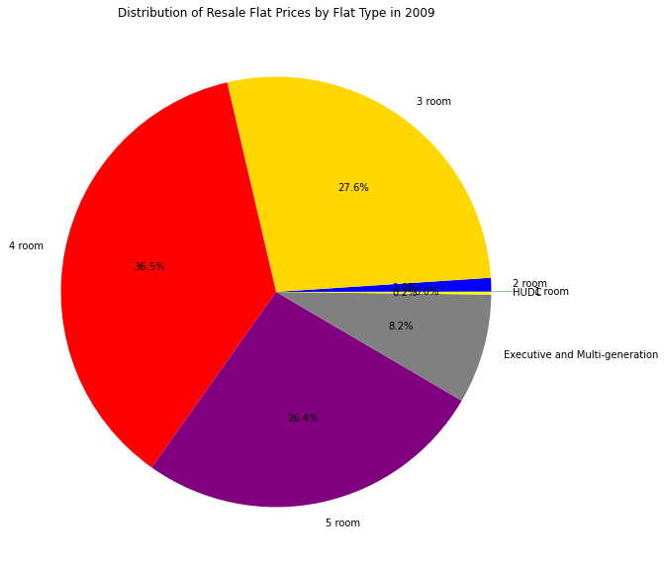
The Pie charts
2009 : Total flats: 39320
2013 : Total flats: 17552
Total the difference is: 44.6%

Slide 21
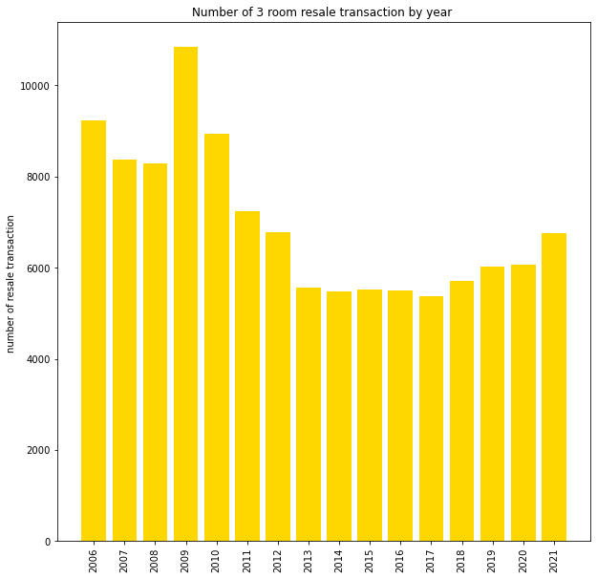
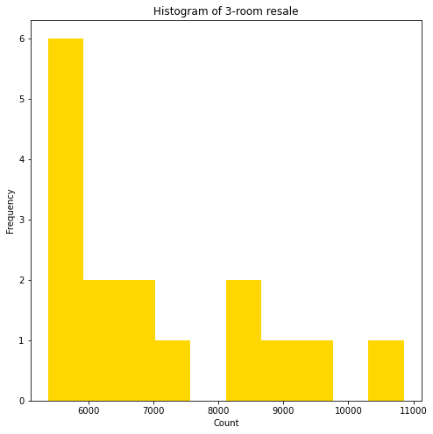
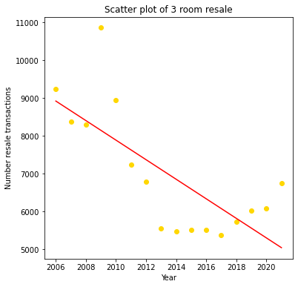
3 room Graphs

Slide 22
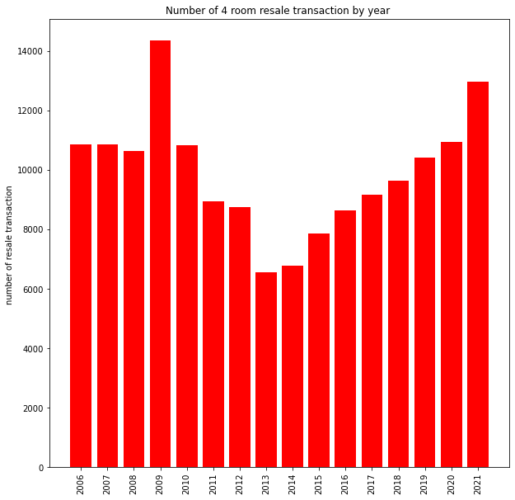
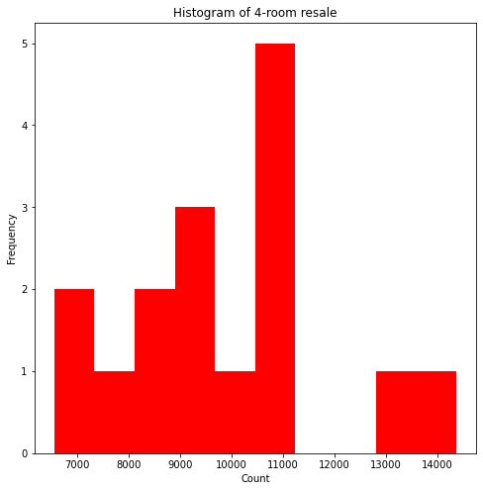
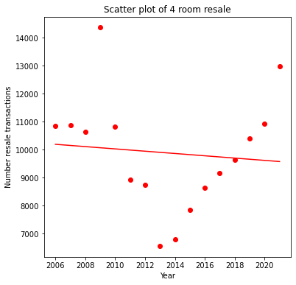
4 room Graphs

Slide 23
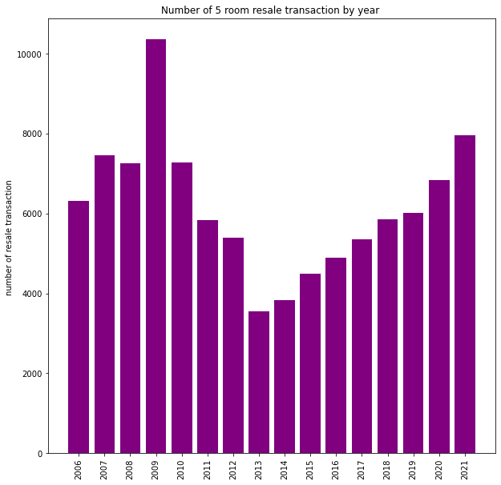
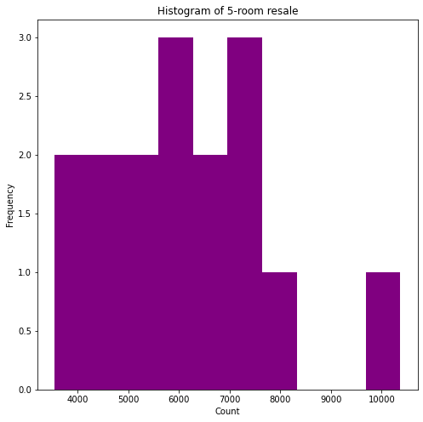
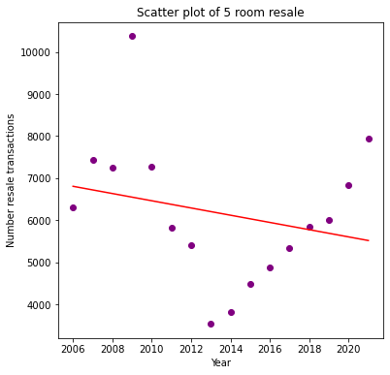
5 room Graphs

Slide 24
Summary for dataset 2
From the graph we can identify the following
1.) 4 room is the most popular type of flat followed by 3 and 5 room. More than 80% of transactions. Pareto principle - 80% to explain the bulk.
2009 10854, 14365, 10369
2013 5553, 6560, 3549
2.) Just before 2013 dip in resale market due to Bidadari estate master plan announcement. 44.6% dip.
3.)After the announcement the market started to recover 2014 onwards.

Slide 25
Information about the dataset 3
ResaleflatpricesbasedonregistrationdatefromJan2017onwards.csv
The data-set is from the years 2017 to 2024.
We will create a year column and drop the year month column
We will see the effect of COVID in 2020 on resale price.
We will identify features that affect prices of resale flat.
We will create a separate CSV file with the URA planning region and do a left merge with pandas.
We will explore the corelation coefficient of the different planning zones – see if applicable for machine learning?

Slide 26
Title | Column name | Data type | Unit of measure | Description
Month | month | Text | - | Month of sale
Town | town | Text | - | Designated residential area with its own amenities, infrastructure, and community facilities
Flat type | flat_type | Text | - | Classification of units by room size. They range from 2 to 5 rooms, 3Gen units, and Executive units.
Block | block | Text | - | Classification of units by room size. They range from 2 to 5 rooms, 3Gen units, and Executive units.
Street name | street_name | Text | - | A HDB building comprising multiple flats or apartments
Storey range | storey_range | Text | - | Estimated range of floors the unit sold was located on
Floor area sqm | floor_area_sqm | Numeric | - | Total interior space within the unit, measured in square meters
Flat model | flat_model | Text | - | Classification of units by generation of which the flat was made, ranging from New Generation, DBSS, Improved, Apartment
Lease commence date | lease_commence_date | Year (YYYY) | - | Starting point of a lease agreement, marking the beginning of the lease term during which the tenant has the right to use and occupy the leased property
Remaining lease | remaining_lease | Text | - | Remaining amount of time left on the lease.
Resale price | resale_price | Numeric | - | Cost of the flat sold

Slide 27
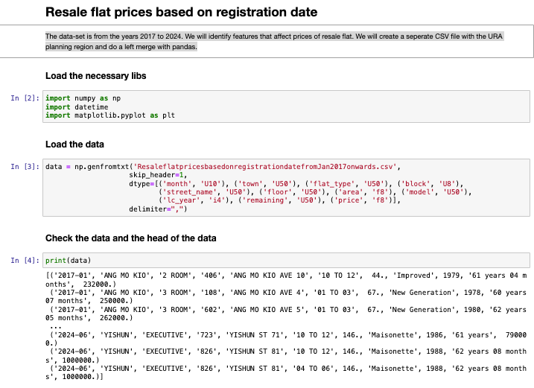
The code

Slide 28
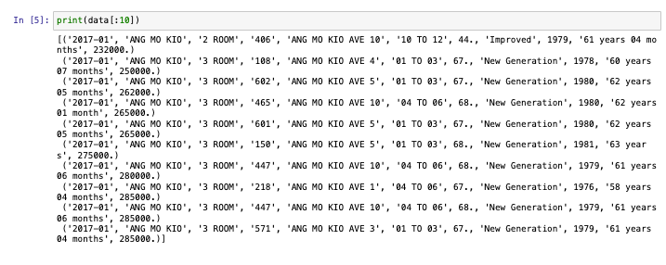
The code

Slide 29
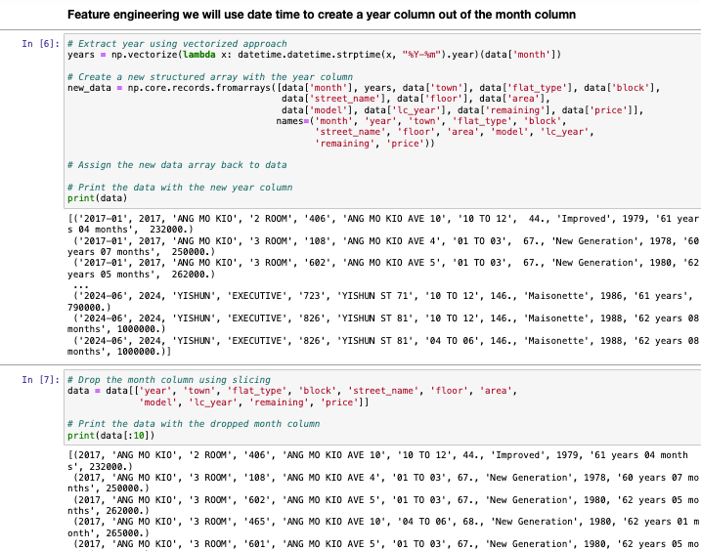
The code

Slide 30
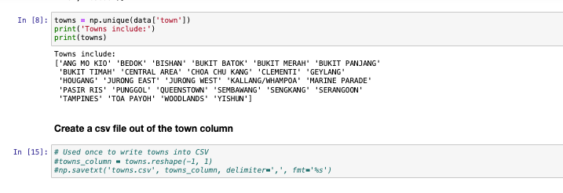
The code

Slide 31
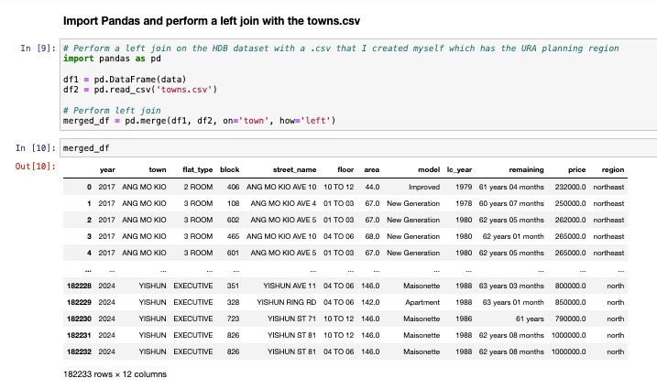
The code

Slide 32
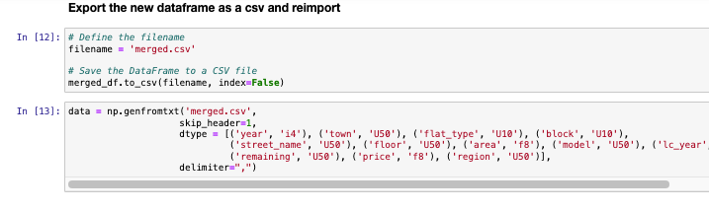
The code

Slide 33
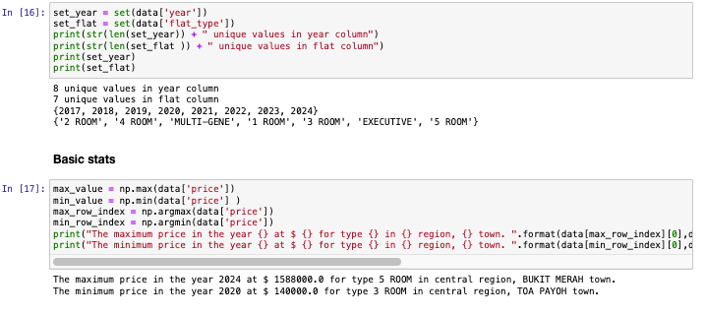
The code

Slide 34
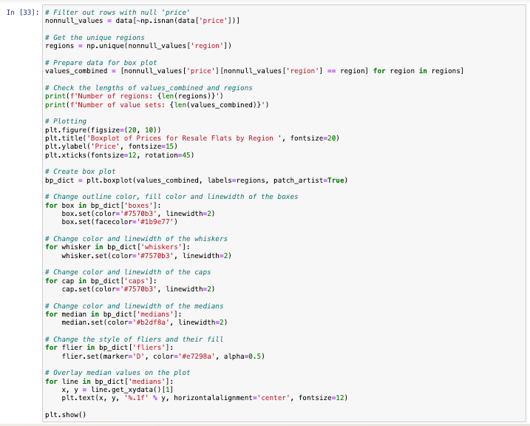
The code

Slide 35
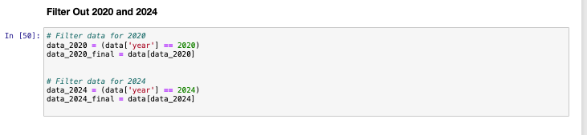
The code

Slide 36
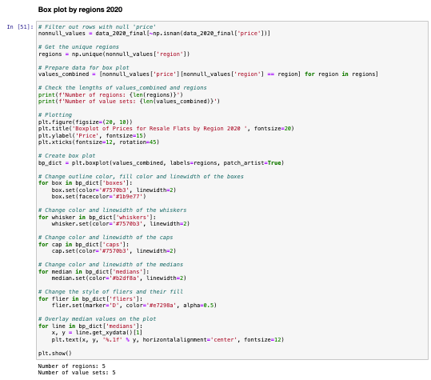
The code

Slide 37
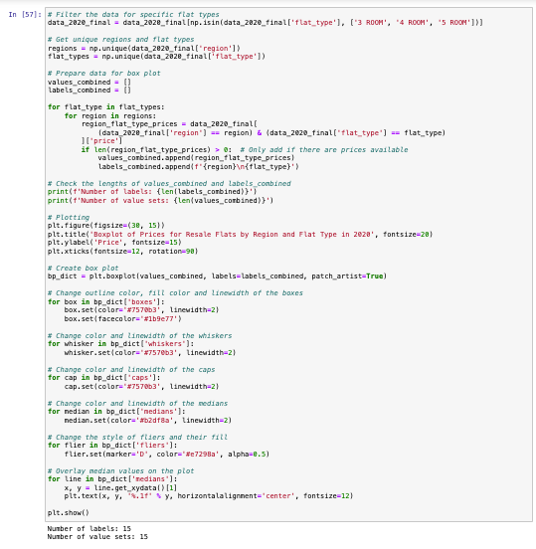
The code

Slide 38
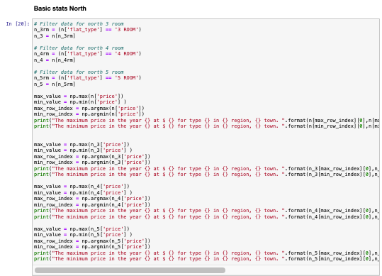
The code

Slide 39
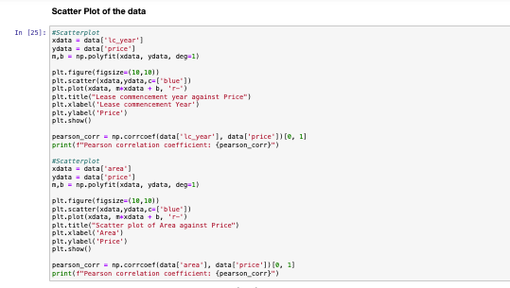
The code

Slide 40
The stats Overall
The maximum price in the year 2024 at $ 1588000.0 for type 5 ROOM in central region, BUKIT MERAH town.
The minimum price in the year 2020 at $ 140000.0 for type 3 ROOM in central region, TOA PAYOH town.

Slide 41
The stats North
The maximum price in the year 2024 at $ 1410000.0 for type EXECUTIVE in north region, BUKIT TIMAH town.
The minimum price in the year 2023 at $ 150000.0 for type 2 ROOM in north region, WOODLANDS town.
The maximum price in the year 2023 at $ 570000.0 for type 3 ROOM in north region, BUKIT TIMAH town.
The minimum price in the year 2019 at $ 178000.0 for type 3 ROOM in north region, WOODLANDS town.
The maximum price in the year 2024 at $ 900000.0 for type 4 ROOM in north region, BUKIT TIMAH town.
The minimum price in the year 2020 at $ 218000.0 for type 4 ROOM in north region, WOODLANDS town.
The maximum price in the year 2024 at $ 1222800.0 for type 5 ROOM in north region, BUKIT TIMAH town.
The minimum price in the year 2019 at $ 270000.0 for type 5 ROOM in north region, WOODLANDS town.

Slide 42
The stats Central
The maximum price in the year 2024 at $ 1588000.0 for type 5 ROOM in central region, BUKIT MERAH town.
The minimum price in the year 2020 at $ 140000.0 for type 3 ROOM in central region, TOA PAYOH town.
The maximum price in the year 2024 at $ 1280000.0 for type 3 ROOM in central region, KALLANG/WHAMPOA town.
The minimum price in the year 2020 at $ 140000.0 for type 3 ROOM in central region, TOA PAYOH town.
The maximum price in the year 2023 at $ 1500000.0 for type 4 ROOM in central region, BUKIT MERAH town.
The minimum price in the year 2019 at $ 275000.0 for type 4 ROOM in central region, TOA PAYOH town.
The maximum price in the year 2024 at $ 1588000.0 for type 5 ROOM in central region, BUKIT MERAH town.
The minimum price in the year 2020 at $ 420000.0 for type 5 ROOM in central region, GEYLANG town.

Slide 43
The stats North-East
The maximum price in the year 2024 at $ 1268000.0 for type 5 ROOM in northeast region, ANG MO KIO town.
The minimum price in the year 2018 at $ 170000.0 for type 3 ROOM in northeast region, SERANGOON town.
The maximum price in the year 2024 at $ 780000.0 for type 3 ROOM in northeast region, ANG MO KIO town.
The minimum price in the year 2018 at $ 170000.0 for type 3 ROOM in northeast region, SERANGOON town.
The maximum price in the year 2024 at $ 1038888.0 for type 4 ROOM in northeast region, ANG MO KIO town.
The minimum price in the year 2018 at $ 271000.0 for type 4 ROOM in northeast region, SENGKANG town.
The maximum price in the year 2024 at $ 1268000.0 for type 5 ROOM in northeast region, ANG MO KIO town.
The minimum price in the year 2019 at $ 345000.0 for type 5 ROOM in northeast region, SENGKANG town.

Slide 44
The stats West
The maximum price in the year 2024 at $ 1300000.0 for type 5 ROOM in west region, CLEMENTI town.
The minimum price in the year 2018 at $ 175000.0 for type 2 ROOM in west region, JURONG WEST town.
The maximum price in the year 2024 at $ 820000.0 for type 3 ROOM in west region, CLEMENTI town.
The minimum price in the year 2018 at $ 175000.0 for type 3 ROOM in west region, JURONG WEST town.
The maximum price in the year 2024 at $ 1158000.0 for type 4 ROOM in west region, CLEMENTI town.
The minimum price in the year 2019 at $ 235000.0 for type 4 ROOM in west region, BUKIT PANJANG town.
The maximum price in the year 2024 at $ 1300000.0 for type 5 ROOM in west region, CLEMENTI town.
The minimum price in the year 2020 at $ 300000.0 for type 5 ROOM in west region, JURONG EAST town.

Slide 45
The stats East
The maximum price in the year 2022 at $ 1238000.0 for type EXECUTIVE in east region, PASIR RIS town.
The minimum price in the year 2023 at $ 150000.0 for type 3 ROOM in east region, TAMPINES town.
The maximum price in the year 2024 at $ 643500.0 for type 3 ROOM in east region, PASIR RIS town.
The minimum price in the year 2023 at $ 150000.0 for type 3 ROOM in east region, TAMPINES town.
The maximum price in the year 2024 at $ 893000.0 for type 4 ROOM in east region, BEDOK town.
The minimum price in the year 2020 at $ 250000.0 for type 4 ROOM in east region, TAMPINES town.
The maximum price in the year 2023 at $ 888000.0 for type 5 ROOM in east region, BEDOK town.
The minimum price in the year 2020 at $ 725000.0 for type 5 ROOM in east region, TAMPINES town.

Slide 46
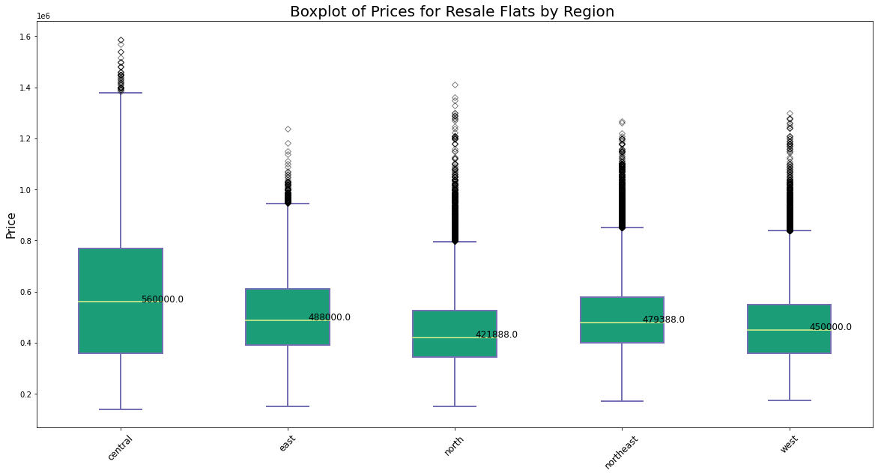
Box Plot Overall
Notes:
Central is the highest with a median of $560,000, east $488,000, north $421,888, ne $479,388 and west $450,000

Slide 47
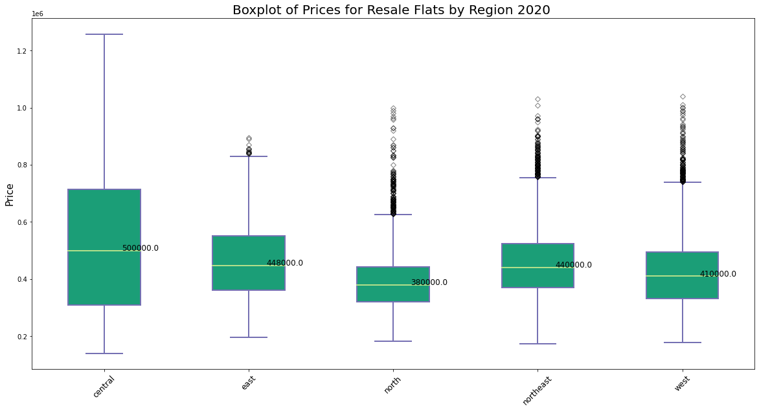
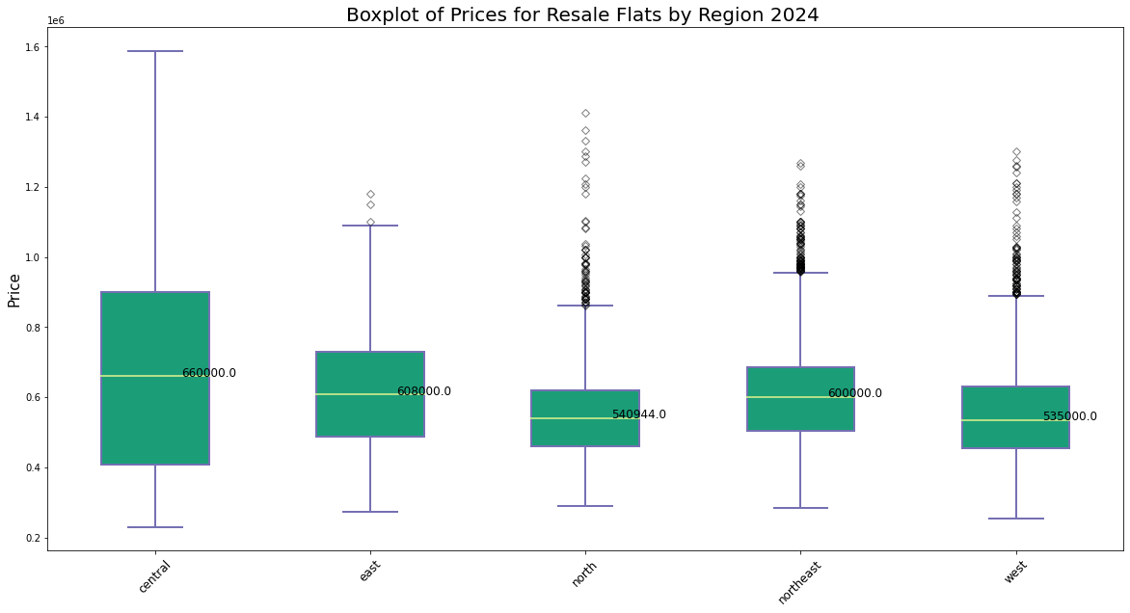
Box Plot 2020 & 2024
Notes:
Central $500,000 2020 and central $660,000,2024

Slide 48
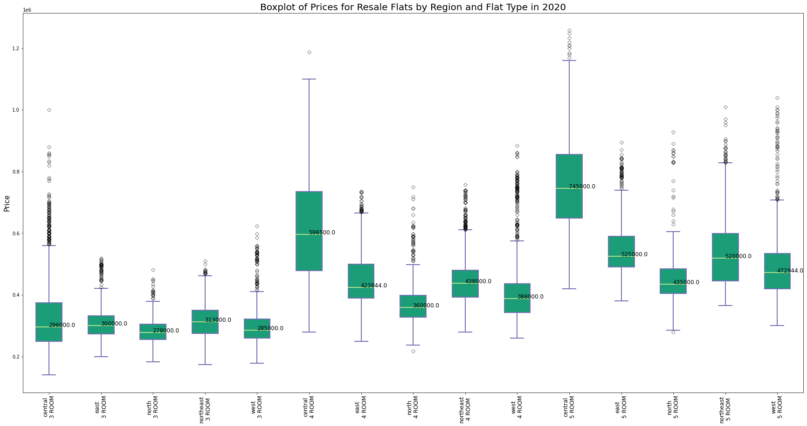
Box Plot 2020 3,4 & 5 room
Notes:
2020 northeast dominates 3 room at $313,000, central for 4 room at 596,500, 5 room 745,000

Slide 49
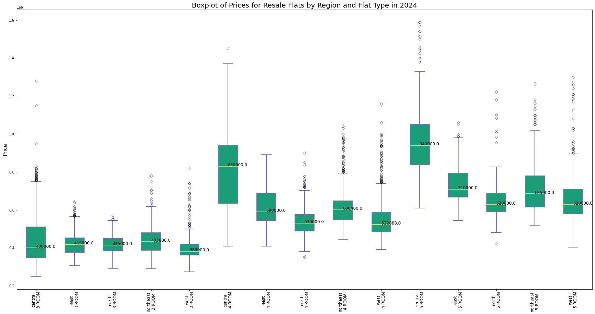
Box Plot 2024 3,4 & 5 room
Pearson correlation coefficient: 0.5990964078495068
Notes:
2024 northeast dominates 3 room at $433,888 , central for 4 room at 830,000 , 5 room 940,000

Slide 50
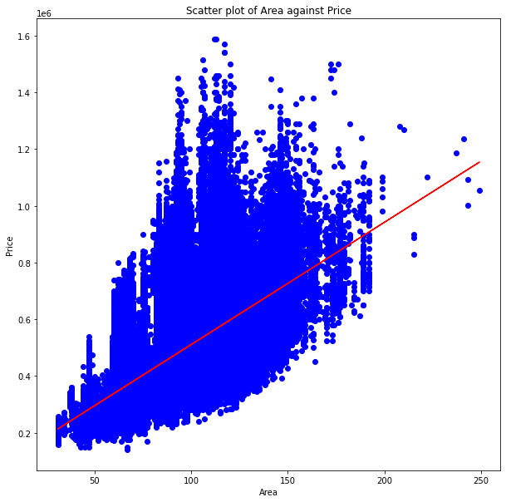
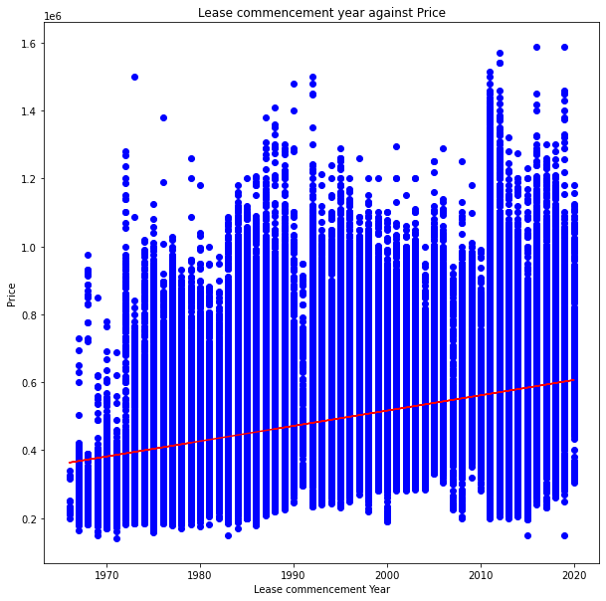
Scatterplot overall
Notes:
Pearson correlation coefficient: 0.36572252352772006
Pearson correlation coefficient: 0.5990964078495068

Slide 51
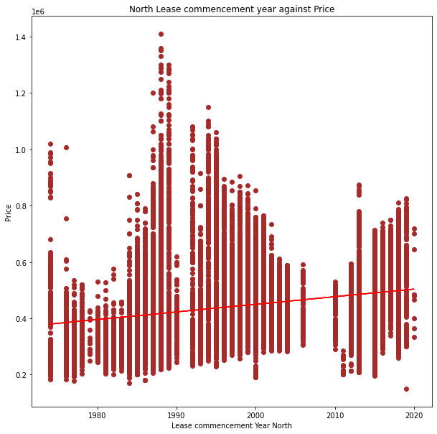
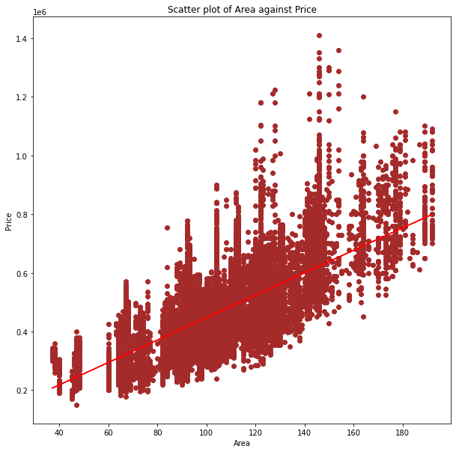
Scatterplot North
Notes:
Pearson correlation coefficient: 0.2394771358365675
Pearson correlation coefficient: 0.6808525620791721

Slide 52
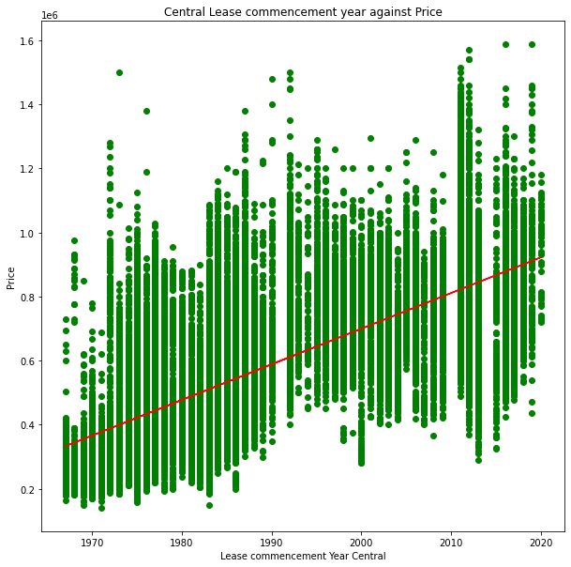
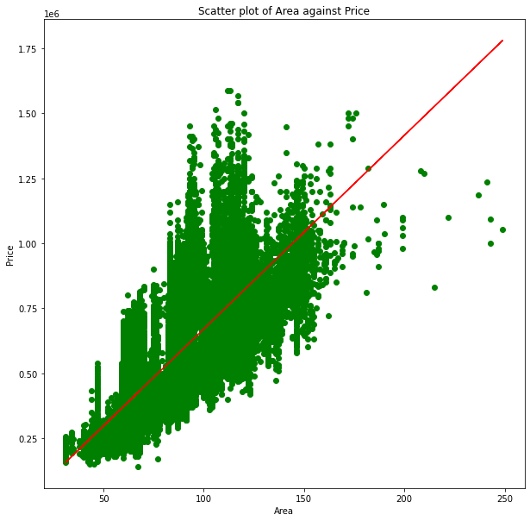
Scatterplot Central
Notes:
Pearson correlation coefficient: 0.7307047606373708
Pearson correlation coefficient: 0.746590542785461

Slide 53


Scatterplot North East
Notes:
Pearson correlation coefficient: 0.30572641981047444
Pearson correlation coefficient: 0.6732939700504

Slide 54


Scatterplot West
Notes:
Pearson correlation coefficient: 0.37682508637077144
Pearson correlation coefficient: 0.6139953998403409

Slide 55


Scatterplot East
Notes:
Pearson correlation coefficient: 0.46834967296334207
Pearson correlation coefficient: 0.7426865170314899

Slide 56
Summary
Only HDB and a Pandemic can impact the resale market by affecting supply and most effectively by creating a new town. Bidadari estate. Watch when the new paya lebar estate is launched.
Area affects price generally.
The most popular flat type is a 4 room flat this is evident in supply.
The dataset is ideal for machine learning as per the coefficient correlation and can be enhanced further by slicing by level of the flats i.e., hi low floors and sub-setting the regions into 3 quadrants. Closer to the CBD and away from the CBD
Properties in central are generally high. The correlation coefficient is generally good for the two sets investigated.
Generally, if the access to the CBD and good schools are good, the flat can fetch a good resale price.

